Slide 1
shelve — Python object persistence

Slide 2
Shelve
The shelve module in Python’s standard library is a simple yet effective tool for persistent data storage when using a relational database solution is not required.
A “shelf” is a persistent, dictionary-like object which is persistently stored in a disk file.
This creates a file similar to dbm database on UNIX like systems.
The values in a shelf can be essentially arbitrary Python objects — anything that the pickle module can handle
The keys are ordinary strings.
Shelf objects support all methods supported by dictionaries. This eases the transition from dictionary based scripts to those requiring persistent storage.

Slide 3
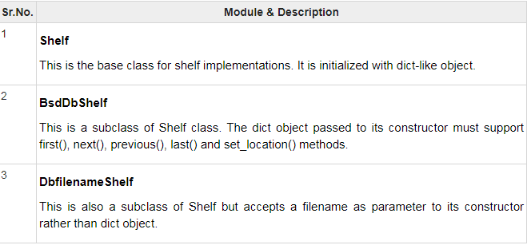
The shelve module defines three classes

Slide 4
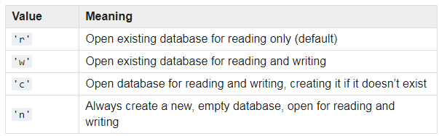
Opening a persistent Dictionary
shelve.open(filename, flag='c', protocol=None, writeback=False)
The filename specified is the base filename for the underlying database. As a side-effect, an extension may be added to the filename and more than one file may be created.
By default, the underlying database file is opened for reading and writing
The optional flag parameter :

Slide 5
Opening a persistent Dictionary(Contd..)
By default, version 3 pickles are used to serialize values. The version of the pickle protocol can be specified with the protocol parameter.
A shelf cannot know when a mutable persistent-dictionary entry is modified. By default modified objects are written only when assigned to the shelf . If the optional writeback parameter is set to True, all entries accessed are also cached in memory, and written back on sync() and close()

Slide 6
Shelf object methods
Shelf.sync()Write back all entries in the cache if the shelf was opened with writeback set to True. Also empty the cache and synchronize the persistent dictionary on disk, if feasible. This is called automatically when the shelf is closed with close().
Shelf.close()Synchronize and close the persistent dict object. Operations on a closed shelf will fail with a ValueError
get()returns value associated with key
items()list of tuples – each tuple is key value pair
keys()list of shelf keys
pop()remove specified key and return the corresponding value.
update()Update shelf from another dict/iterable
values()list of shelf values

Slide 7
Storing Python shelve data
import shelve
# In this step, we create a shelf file.
shfile = shelve.open("shelf_file")
# we create a data object which in this case is a book_list.
my_book_list =['bared_to_you', 'The_fault_in_our_stars',
'The_boy_who_never_let_her_go']
# we are assigning a dictionary key to the list
# which we will want to retrieve
shfile['book_list']= my_book_list
# now, we simply close the shelf file.
shfile.close()

Slide 8
Retrieving Python shelve data :
# At first, we import the 'Shelve' module.
import shelve
# In this step, we create a shelf file.
var = shelve.open("shelf_file")
# Now, this 'var' variable points to all the
# data objects in the file 'shelf_file'.
print(var['book_list'])
# now, we simply close the file 'shelf_file'.
var.close()

Slide 9
Updating Python shelve data :
import shelve
# In this step, we create a shelf file.
var = shelve.open("shelf_file", writeback = True)
# inputting total values we want to add
# to the already existing list in shelf_file.
val1 = int(input("Enter the number of values "))
for x in range(val1):
val = input("\n Enter the value\t")
var['book_list'].append(val)
# Now, this 'var' variable will help in printing
# the data objects in the file 'shelf_file'.
print(var['book_list'])
# to make our changes permanent, we use
# synchronize function.
var.sync()
# now, we simply close the file 'shelf_file'.
var.close()

Slide 10
Example 1
Following code creates a database and stores dictionary into it
import shelve
s = shelve.open("test")
s['name'] = "Ajay"
s['age'] = 23
s['marks'] = 75
s.close()
This will create test.dir file in current directory and store key-value data in hashed form.

Slide 11
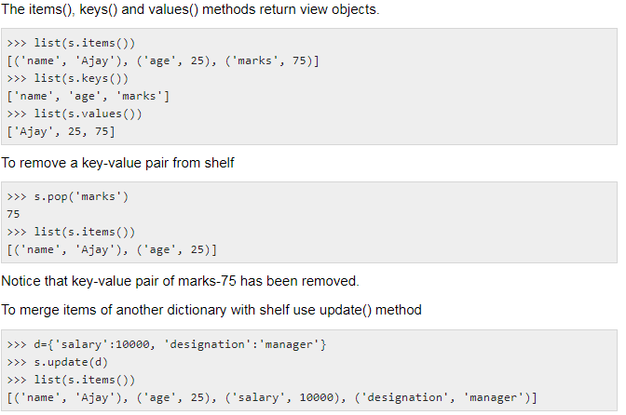

Slide 12
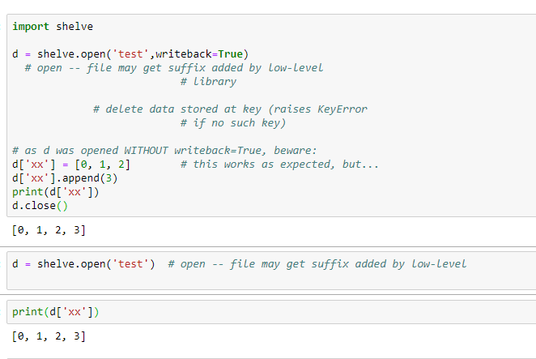
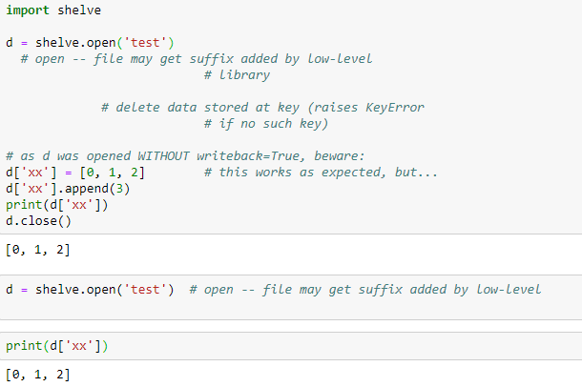
Example2

Slide 13
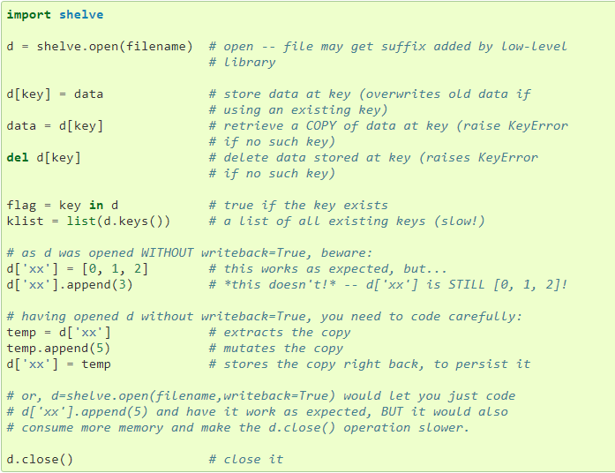
Example3

